Slide 1
DOES READING BOOKS INFLUENCE decisions STUDENTS make?
(This data is from Survey Responses and is not from the entire Udacity Student population.)

Slide 2
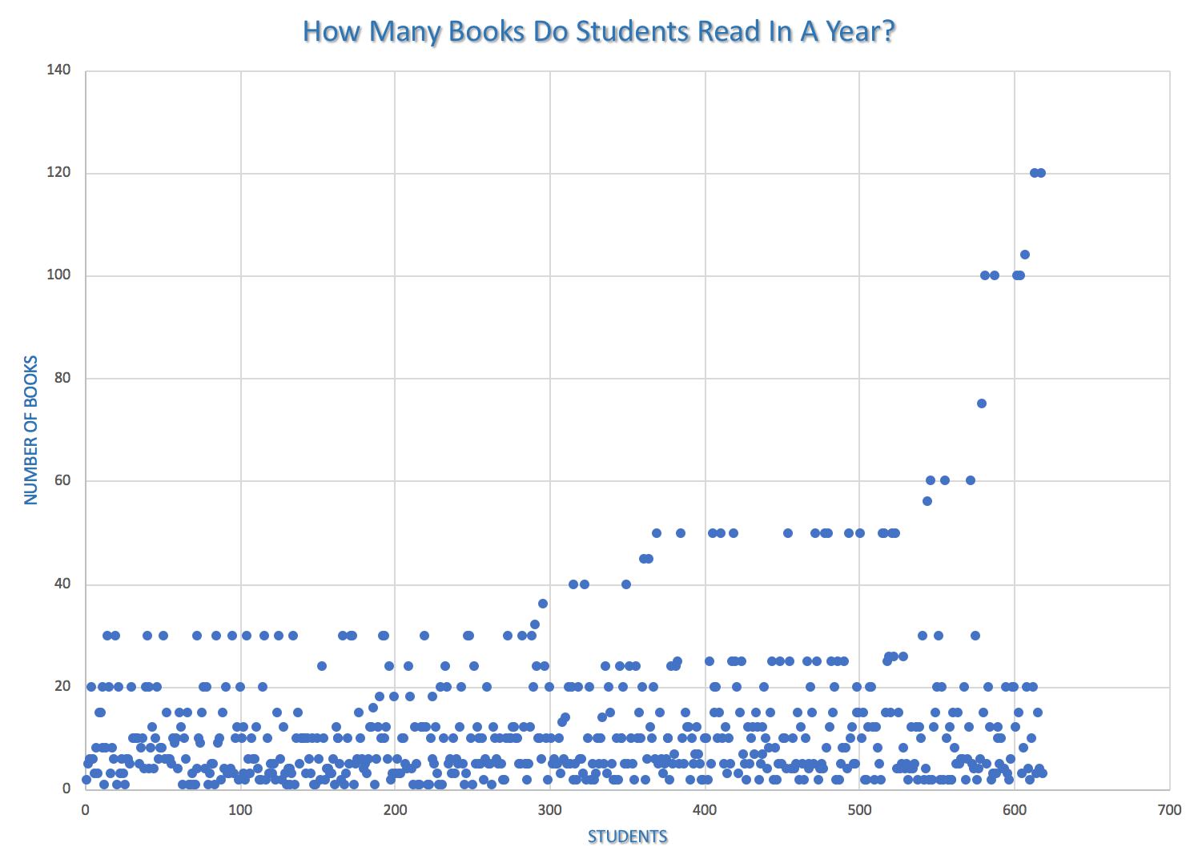
How many books do students read?
With a glance at the this scatter plot, it seems if the majority of the students read less than 40 books a year.
But let’s look at more data to see if this has any influence on students decisions.
X-axis need to be age or work experience and talk relations with the data. Positive correlation between.
Please note for this presentation “read” or “reading” will be understood to include listening to audible books.

Slide 3
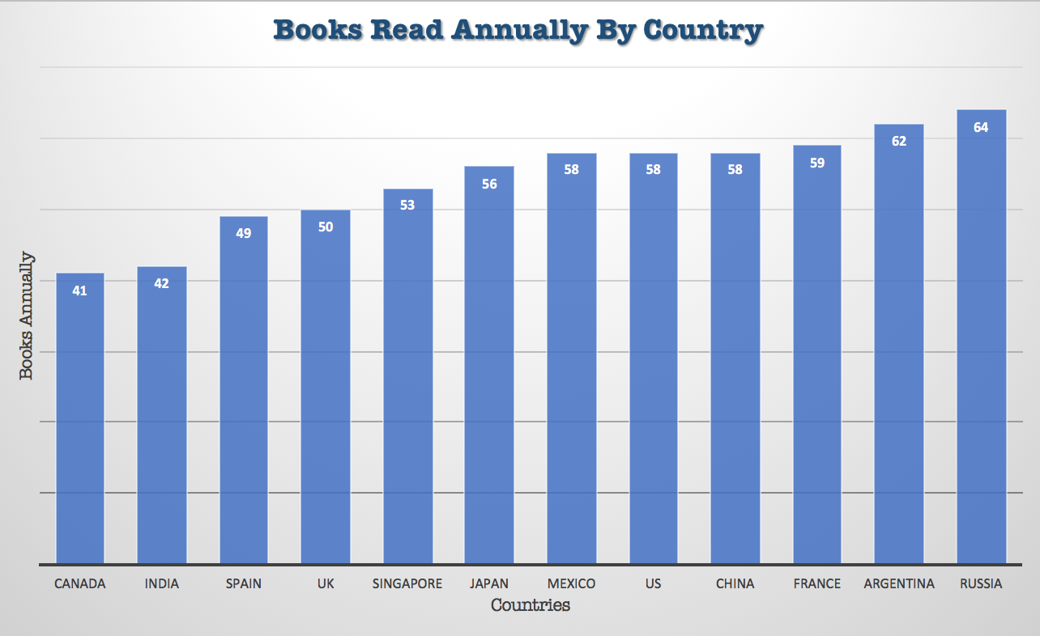
Do students from certain countries read more?
Upon looking at this chart, it shows a gradual increase in reading from the least at 41 books for Canada and the greatest at 64 books from Russia.
Without having a more controlled survey, knowing how the students view reading books, and what types of books; we can only say that Russian students read more that students from any other county.
Let’s look at more data and see if reading books influence these students.

Slide 4
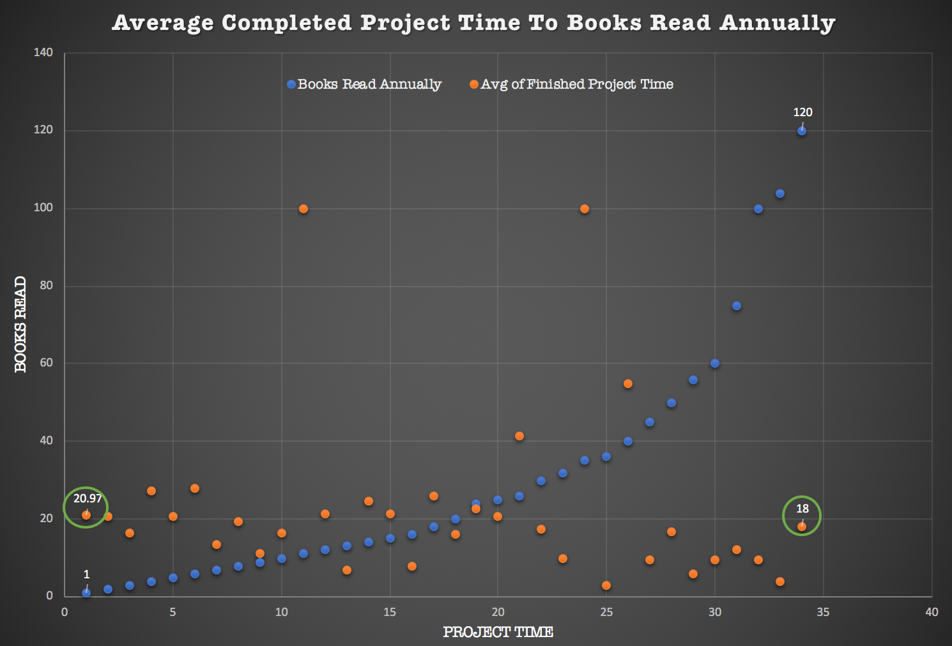
Do books influence project time?
Looking at this combined chart, it seems that there is not a significant difference between the opposing ends of students who read 1 book a year and students who read 120 books a year as the average project completion for both is 20.97 and 18.0.
Let’s compare the two countries with the least amount of books annually, Canada, who read and the greatest amount of books annually, Russia, see if this changes anything.

Slide 5
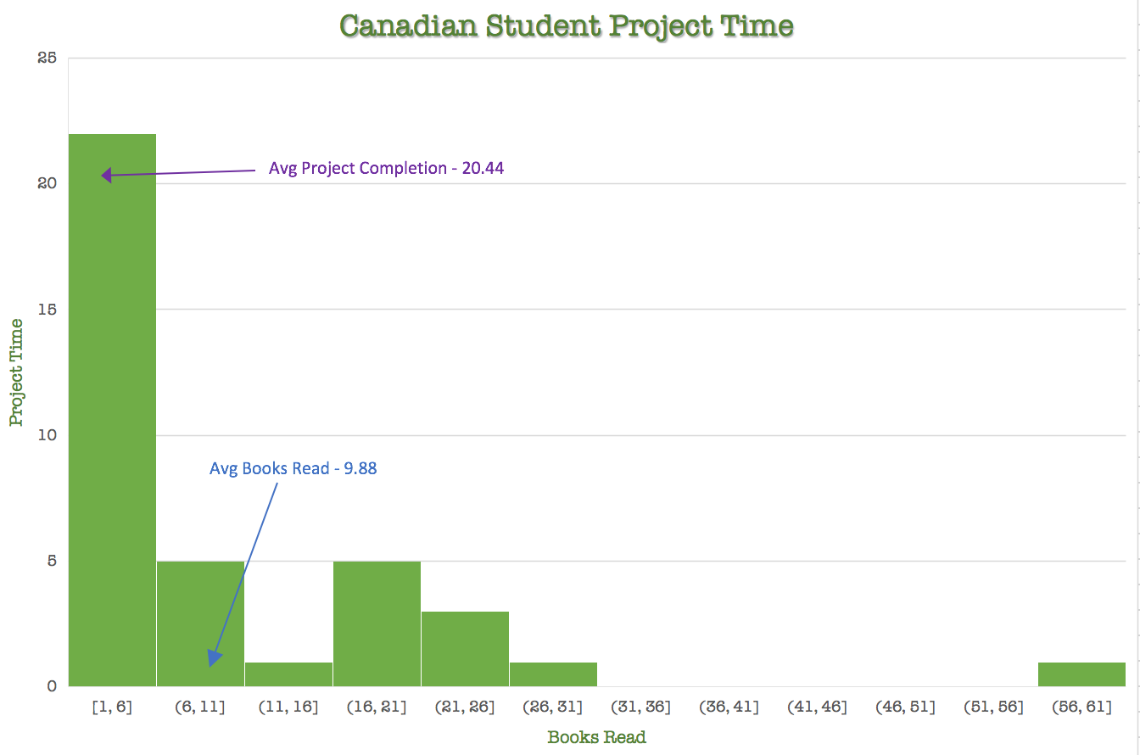
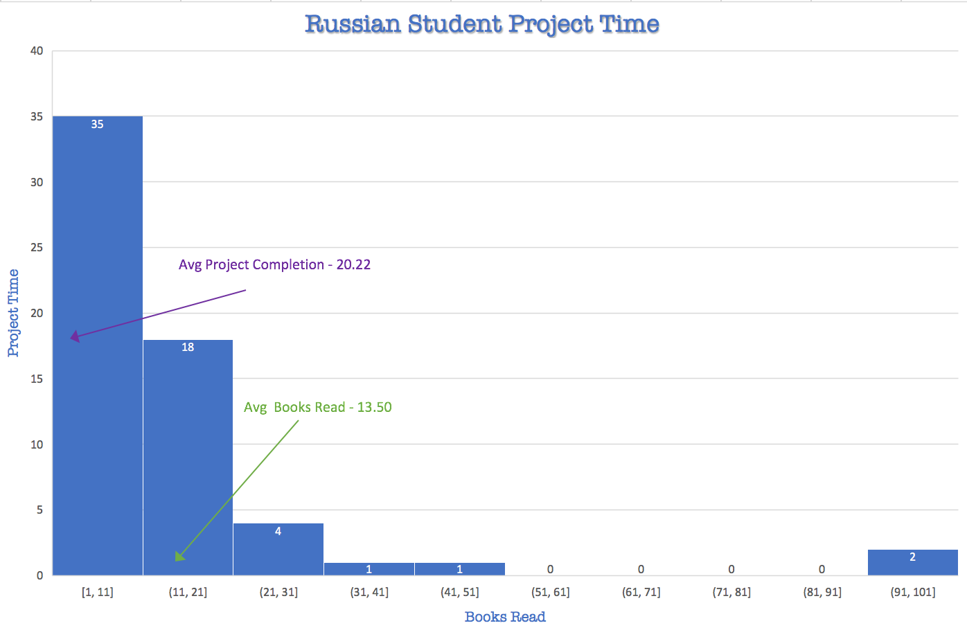
Do students who read more complete projects faster?
Let’s compare the country with the fewest books read annually, Canada, and the country with the most books read annually, Russia.
Looking at the histograms, both distributions appear to be positively skewed. Therefore, the mean for each is higher than the median.
The mean(average) for each project completion time is very close at approximately 20 hours for each. Russians may average a higher books read by students, but Canadians and Russians seem to complete projects in about the same amount of time.
However, the standard deviation project time for Canadians is 18.18 hours, while the standard deviation Russians is 19.87. It seems that perhaps even with more books read per year Russian Students and Canadian Students complete projects in approximately the same amount of time.

